Slide 1


Presented by,
Name : SRI VIDHYA.B
Reg.No : 8115U23EC110
Roll.No : ECB2347
Dept : Electronics and Communication Engineering

Slide 2
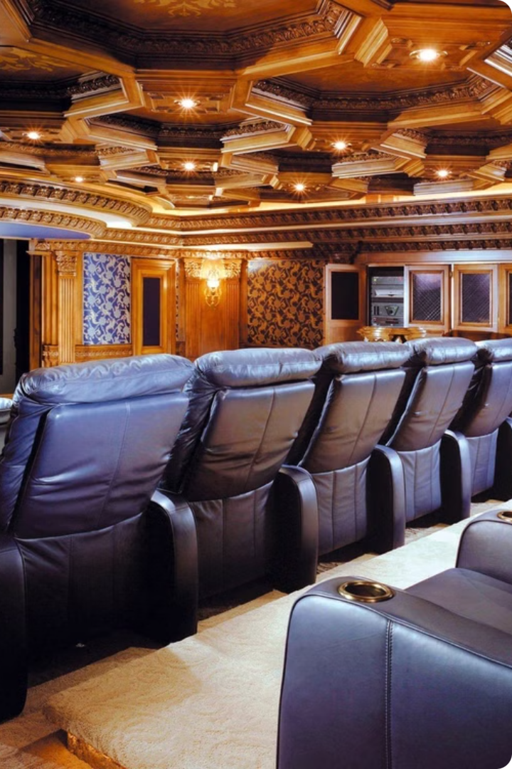
Movie Ticket Booking System
Browse showtimes, select your movie with the movie choice, and Calculates the total cost in just a few clicks.

Slide 3
Objective
Convenience
Efficiency
Accessibility
Provide a user-friendly platform that allows customers to easily choose their ticket choices from the comfort of their homes or on-the-go.
Making easily the ticket booking process, minimizing wait times and enhancing the overall customer experience.
Ensure the system is accessible across various devices and platforms, catering to the diverse needs of modern moviegoers.

Slide 4
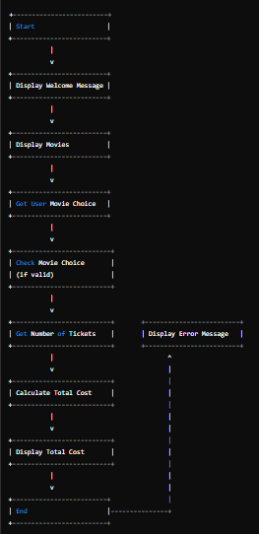
Architecture diagram

Slide 5




Data Structures Used
Strings
For loop
Dictionary
Security
Efficient storage and retrieval of movie information, user data, and booking details.
You can create a loop to print each movie in a list by accessing each element in turn.
Used to holds the pairs of values to the corresponding key:value pairs.
Supports multiple payment methods for safe and hassle-free transactions .

Slide 6




Module Completion
Movie_choice
Movie.items( )
Total_cost
It enables to enter the number of tickets and it will show the total cost of the ticket.
Enjoy
Customers can easily give the choice of movie and give the number of movies.
It will display all the saved movies and name of the movies.
Customers can confidently proceed to the theater and enjoy the movie.

Slide 7
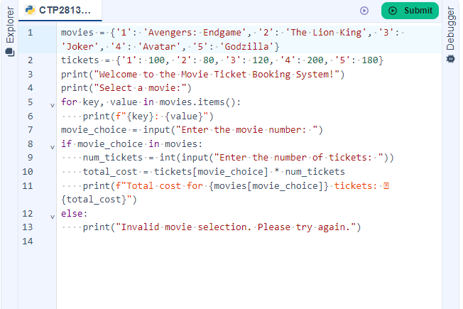
Coding Implementation

Slide 8
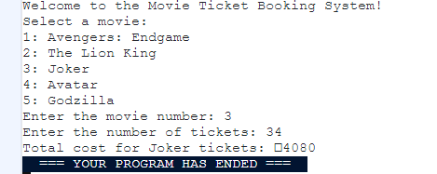
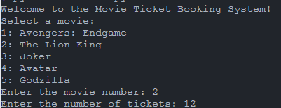
Output Display Movies

Slide 9
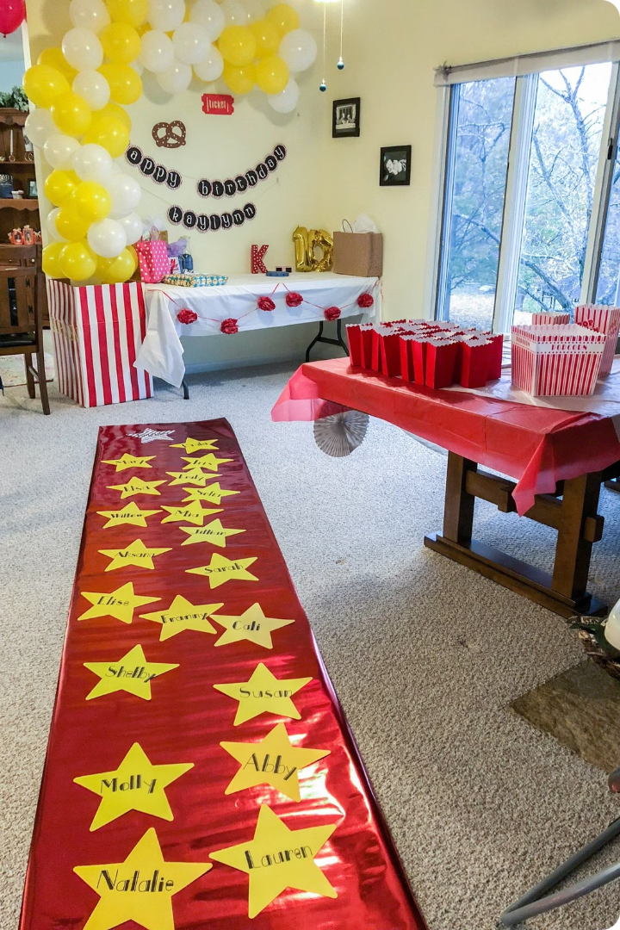
Thank You
We appreciate your interest in our movie ticket booking system. We strive to provide a seamless and enjoyable experience for all our customers. Feel free to reach out if you have any further questions or feedback.

